Slide 1
Random Password Generator, Quiz &
Pizza Ordering.

Slide 2
Introduction.
Random Password Generator is that generate password according to your input needs. Like it generates without special characters(only characters) or with special characters.

Slide 3
Why use Random Password Generator.
Because people often use their names,birth dates or some other thing relating to them as password.
Many of them use same password with more than one account for their convenience.
Also people do not change their password regularly .

Slide 4
How it works?
It generates password randomly with special characters or without them.
Example :
queen , walmart music 2 MUSIC + } % XBOX , MUSIC skype ; QUEEN 9
q,wm2M+}%X,Ms;Q9

Slide 5
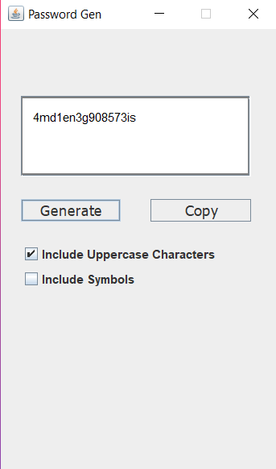
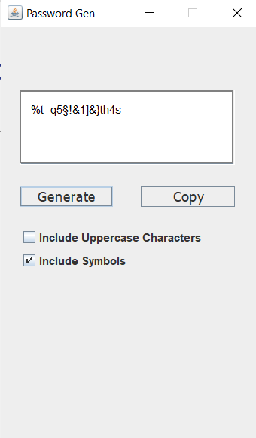
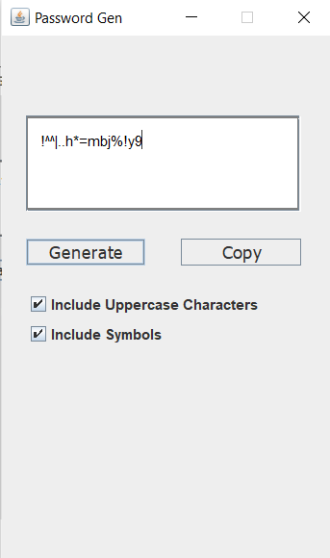
Samples of Random Password Generator

Slide 6
Pizza ordering.
Existing system:
Customers need to personally go to the pizza shop, check their menu, place an order and pay the bill.
Proposed system:
Customers can order food from their home through the smartphones.
The order can be collected based on the token/receipt number provided.

Slide 7
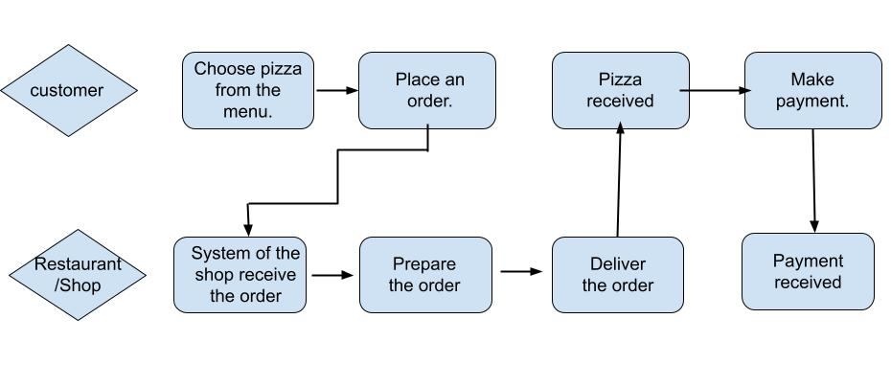
How it works?

Slide 8
Benefits.
Make the ordering process easy.
Convenient.
Greater reach.
More options.

Slide 9
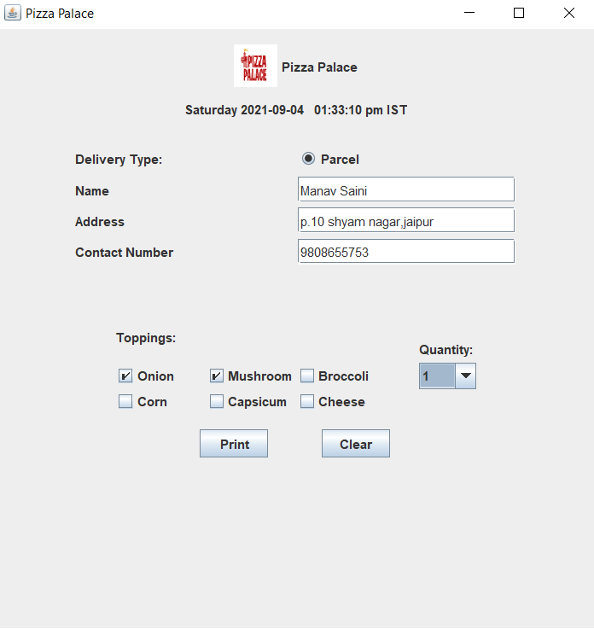
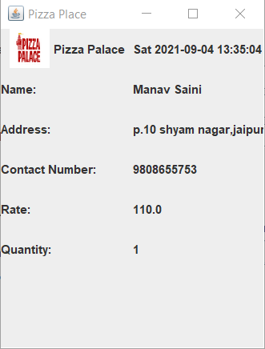
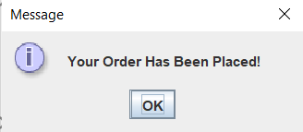
Samples of Pizza ordering

Slide 10
Quiz.
Quiz is a GUI(Graphical user interface) based application system where questions are printed above page and answers are below page.
It can easily Insert,Delete and Modify.
The main objective of OQS is to efficiently evaluate the candidate through a fully automated system that not only saves lot of time but also gives fast results.

Slide 11
Benefits.
Save time .
Can be more interactive.
Keeps record.
Also analyse the performance.

Slide 12
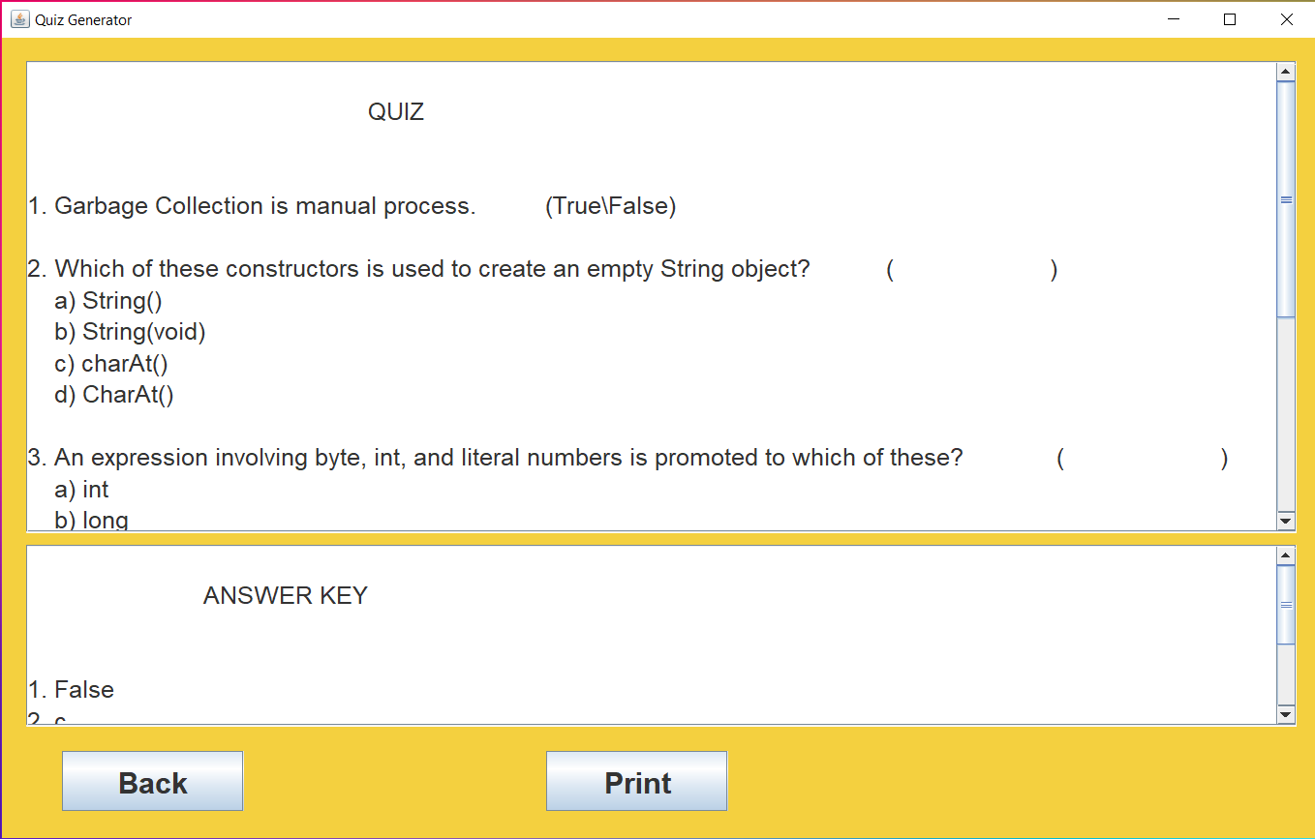
Samples of Quiz

Slide 13
